Slide 1
DVWA Web Application
Penetration Testing
Project 3

Slide 2
Introduction
My name is Noman Ahmed
Location Quetta,balochistan,Pakistan
Background Bachelor in Information Technology from BUITEMS University. I have two-year experience in computer networks and now I learn with IEC in a field cybersecurity course.

Slide 3
Project Introduction
Perform a minimum of 10 web application penetration testing of DVWA.
Create a penetration testing report.
Host the DVWA web application on your own network and never attack or test anyone's assets without authorization.

Slide 4
Project Introduction
What is penetration testing?
Penetration testing, also known as pen testing, is a method of evaluating the security of a computer system, network, or web application by simulating an attack from a malicious source. The goal of penetration testing is to identify vulnerabilities in the target system before they can be exploited by real attackers.
What is DVWA?
DVWA stands for Damn Vulnerable Web Application. It is a web application intentionally designed with known vulnerabilities for the purpose of practicing and improving web application security testing skills. The application includes a range of vulnerabilities such as SQL injection, cross-site scripting, and file inclusion vulnerabilities that users can exploit and try to fix. It is commonly used as a training tool for security professionals and students to gain hands-on experience in identifying and fixing web application vulnerabilities.

Slide 5
What is Severity Risk?
Critical: A vulnerability or threat that could result in the complete compromise of a system or network, leading to significant financial, reputational, or operational damage.
High: A vulnerability or threat that could result in the partial compromise of a system or network, leading to serious financial, reputational, or operational damage.
Medium: A vulnerability or threat that could result in the unauthorized access or disclosure of sensitive information, or minor disruption to operations.
Low: A vulnerability or threat that has minimal impact on the confidentiality, integrity, or availability of data or systems.

Slide 6
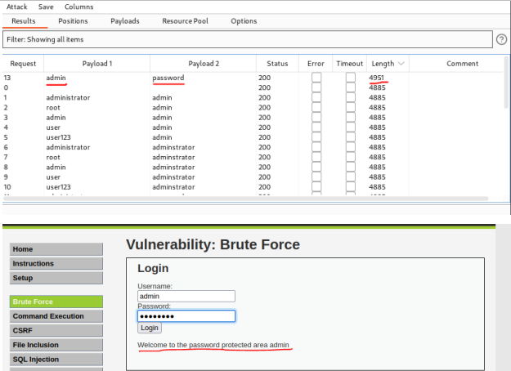
A brute force attack is a method of cracking a password or encryption key by trying every possible combination until the correct one is found. It is commonly used against weak passwords and encryption keys and can be prevented by using strong passwords and encryption keys, limiting login attempts, and implementing multi-factor authentication.
Brute Force Attack
Severity Low

Slide 7
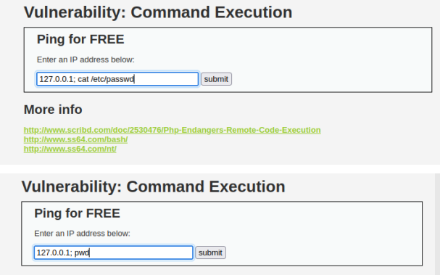
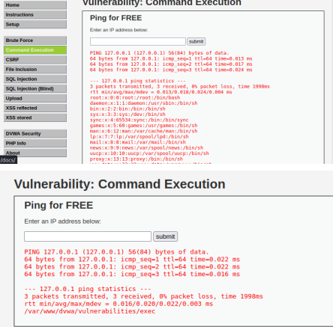
Command Execution vulnerability, an attacker can execute arbitrary commands on the server that is hosting the DVWA application. The vulnerability exists because the application fails to properly sanitize user input before executing system commands. This can allow an attacker to inject malicious code into the input fields of the application, which can then be executed on the server.
Command Execution
Severity Critical

Slide 8
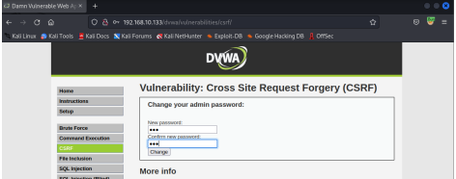
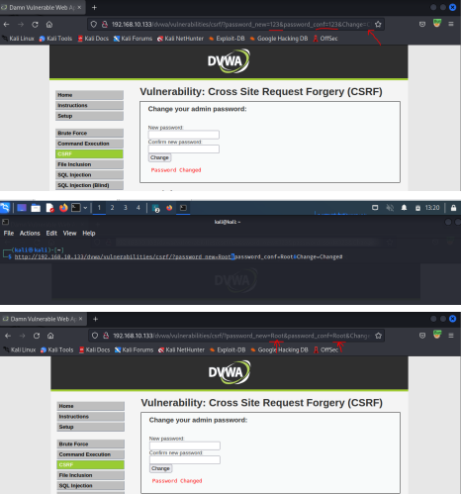
Cross-Site Request Forgery (CSRF) is a type of web application vulnerability that allows an attacker to trick a user into unknowingly submitting a malicious request. The attacker can exploit this vulnerability to perform unauthorized actions on behalf of the user, such as changing their password, transferring funds, or deleting data.
Cross-Site Request Forgery (CSRF)
Severity Medium

Slide 9
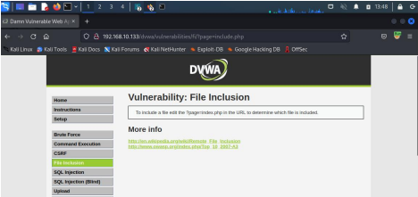
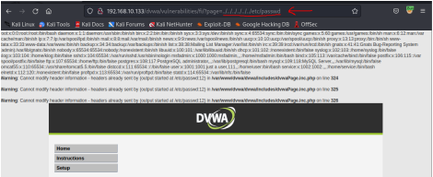
file inclusion vulnerabilities can be exploited by modifying the value of the "page" parameter in the URL. By manipulating this parameter, an attacker can include a file that contains malicious code, such as a PHP script that can execute arbitrary commands on the server.
File Inclusion
Severity Critical

Slide 10
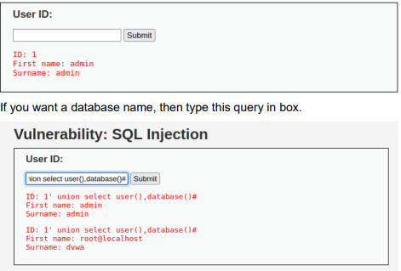
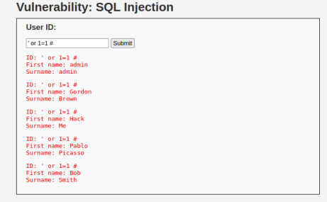
SQL Injection is a type of web application security vulnerability that allows attackers to inject malicious SQL code into input fields of a web application to access or manipulate the database behind it. In DVWA's case, the SQL Injection vulnerability is deliberately included as a means for users to practice identifying and exploiting the vulnerability
SQL Injection
Severity Critical

Slide 11
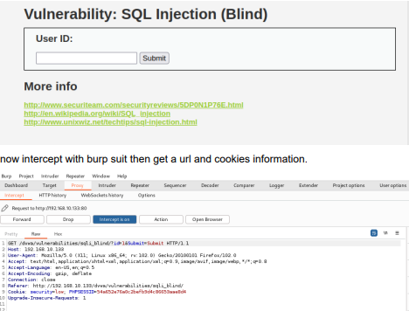
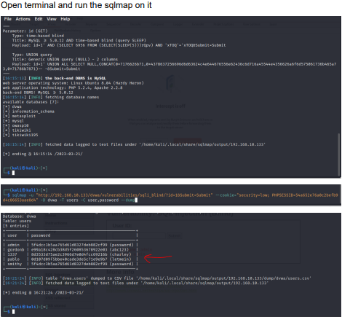
DVWA's Blind SQL Injection vulnerability requires attackers to use more sophisticated techniques to extract information from the database, such as time-based or Boolean-based attacks, as the web application does not display the results of the injected SQL code.
SQL injection (Blind)
Severity Critical

Slide 12
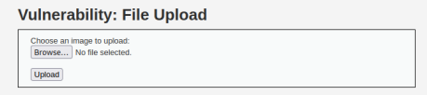
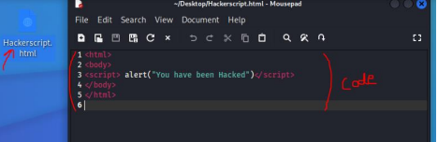
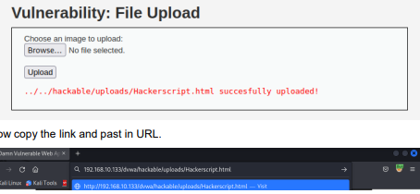
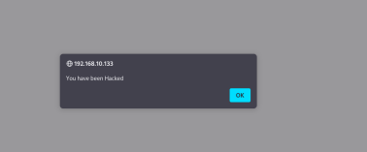
File Upload is a web application vulnerability that allows an attacker to upload malicious files onto a web server by exploiting insecure file upload functionality. This vulnerability can enable an attacker to execute arbitrary code on the server, access sensitive information, or launch further attacks against other users or systems.
File Upload
Severity Critical

Slide 13
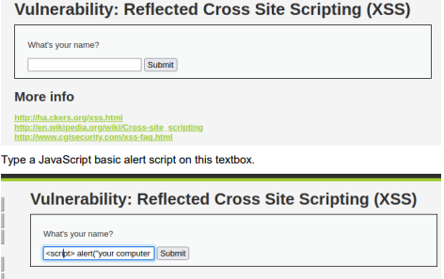
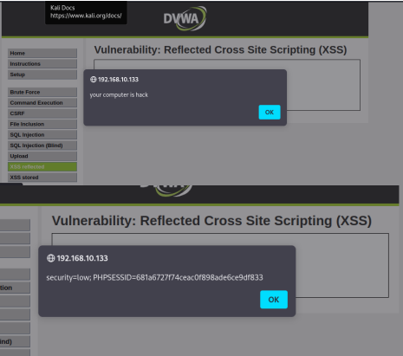
Reflected XSS can be exploited by inserting malicious code into input fields on a web page. When the victim submits the form, the malicious code is reflected back in the response from the server, and is executed in the victim's browser. This vulnerability can be mitigated by properly validating and sanitizing user input, as well as encoding output to prevent it from being interpreted as code.
Reflected Cross Site Scripting (XSS)
Severity High

Slide 14
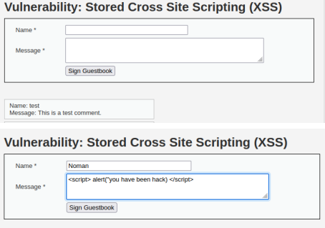
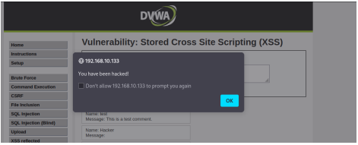
Stored XSS can be exploited by injecting malicious code into input fields that are then stored in a database and displayed to other users of the application. This vulnerability can be mitigated by properly validating and sanitizing user input, as well as encoding output to prevent it from being interpreted as code.
Stored Cross-Site Scripting (XSS)
Severity High

Slide 15
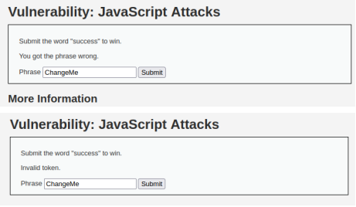
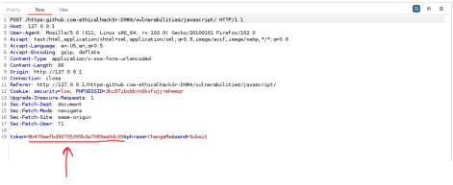
JavaScript is a very capable programming language. An attacker can use these abilities, combined with XSS vulnerabilities, simultaneously as part of an attack vector. So instead of XSS being a way just to obtain critical user data, it can also be a way to conduct an attack directly from the user’s browser.
JavaScript
Severity Low

Slide 16
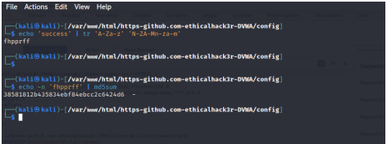
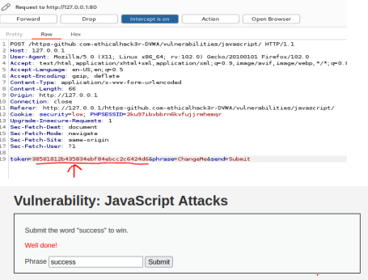

Slide 17
In conclusion, the penetration testing of the DVWA web application has revealed several vulnerabilities that could potentially be exploited by attackers to gain unauthorized access to sensitive information or perform other malicious activities. The vulnerabilities identified include SQL Injection, Command Execution, Cross-Site Scripting (XSS), and Cross-Site Request Forgery (CSRF).
Thank you to listen me if any question please ask me now

